Slide 1
“CEQA AT 40” U.C. DAVIS LAW SCHOOL Applying CEQA in Challenging Times & Contexts November 4, 2011
Meea Kang, President, Domus Development, LLC &
California Infill Builders Association

Slide 2
CALIFORNIA INFILL BUILDERS ASSOCIATION
California Infill Builders Association is a non-profit trade group of builders and developers. We promote the business of developing great projects and neighborhoods in California’s existing towns and cities.
Infilling California is good for the bottom line and will improve the environment and quality of life.
Lower costs to governments
Lower costs to families
Lower costs to businesses
Less impact on agriculture and open space
Less traffic and shorter commutes
Greater energy savings than home efficiency alone
Cleaner air and healthier people
Closer families and stronger communities
Domus Development, LLC
INFILL DEVELOPMENT

Slide 3
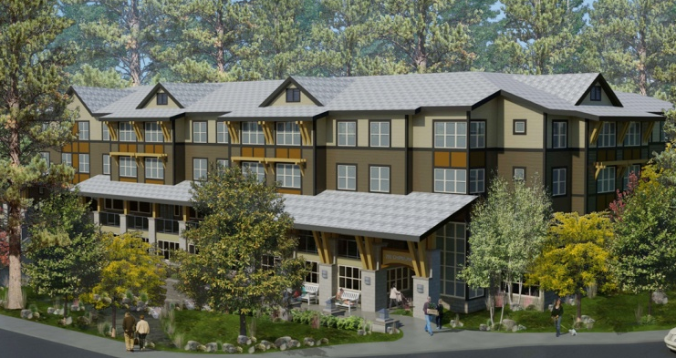
DOMUS DEVELOPMENT, LLC
Creating extraordinary homes,
building strong communities.
Formed in 2003 by developers and investors with more than four decades of experience
Creates sustainable communities that enhance the living experience of residents while benefiting the surrounding neighborhood
Varied backgrounds enable us to provide leadership to the entire project team
Domus is a founding member of the California Infill Builders Association (CIBA)
Domus Development, LLC
SMARTER GROWTH

Slide 4
RECENT CEQA EXEMPTIONS
Domus Development, LLC
INFILL DEVELOPMENT

Slide 5
LINCOLN COURT, OAKLAND
82 units of housing for extremely-low & very-low income seniors
30% set aside for seniors with disabilities
Provision of onsite services makes it a model for supportive senior housing
Infill development along transit rich corridor, near established neighborhood offering grocery, shopping, library, park etc)
Domus Development, LLC
INFILL DEVELOPMENT
Notes:
5

Slide 6
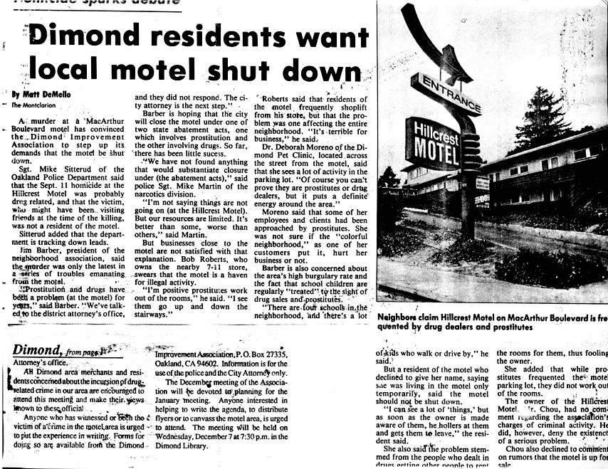
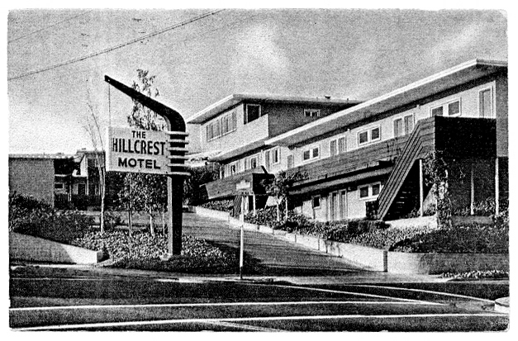
Domus Development, LLC
INFILL DEVELOPMENT
Notes:
6

Slide 7
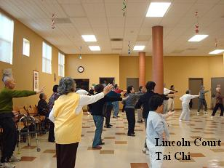
LINCOLN COURT, OAKLAND
Class 32: Infill Exemption
Received all entitlements and completed design review in 6 months.
City was not demanding and costly/time consuming mitigation measures were not required.
Domus Development, LLC
INFILL DEVELOPMENT
Notes:
7

Slide 8
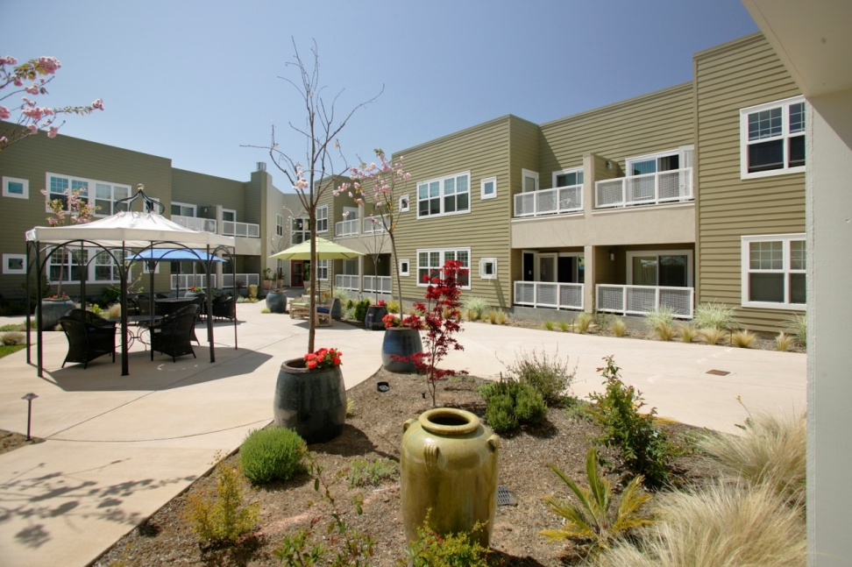
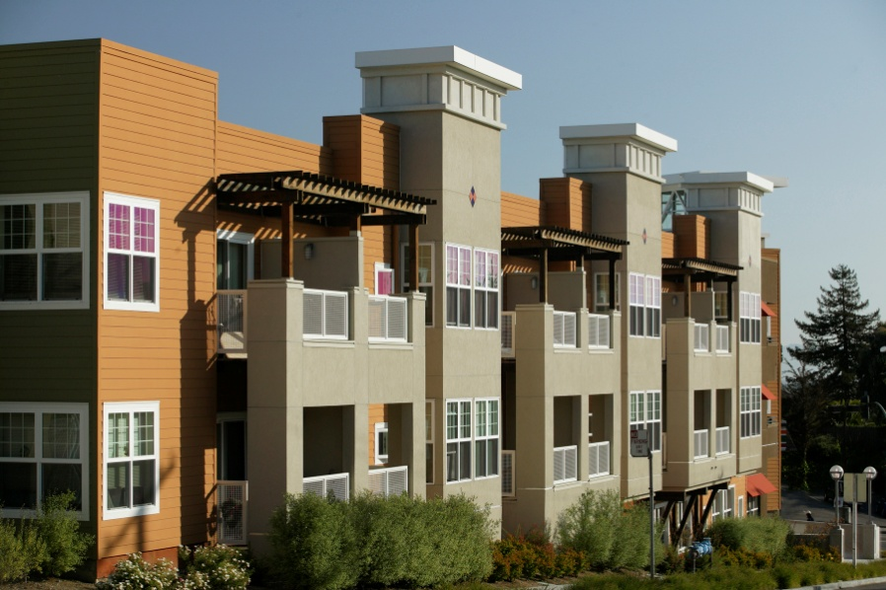
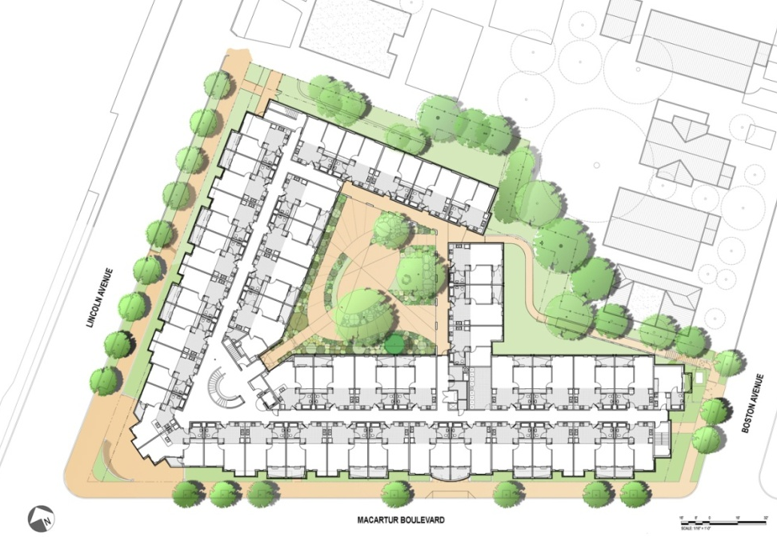
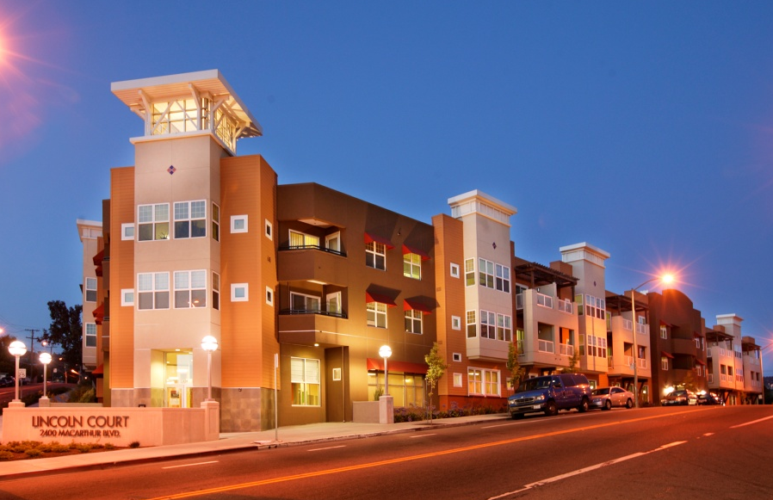
LINCOLN COURT, OAKLAND
Central courtyard for resident activities
Domus Development, LLC
INFILL DEVELOPMENT
Notes:
8
People can walk and socialize in courtyard. Designed to encourage interaction and movement.

Slide 9
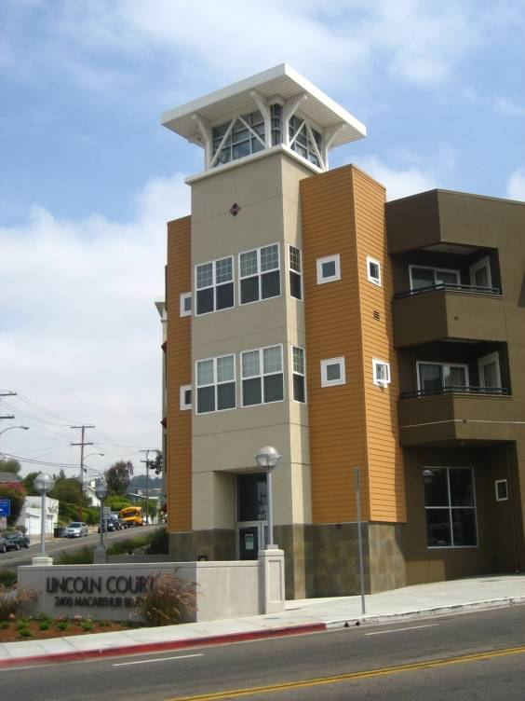
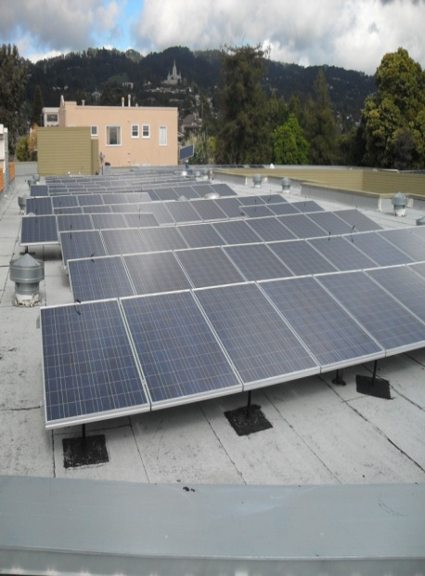
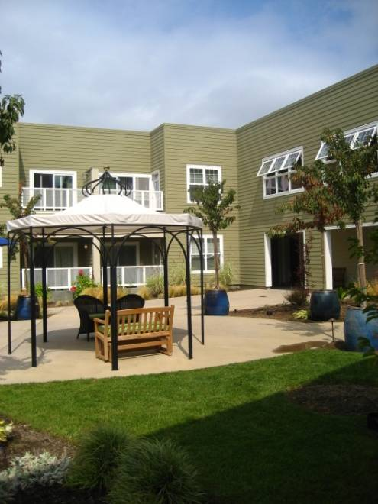
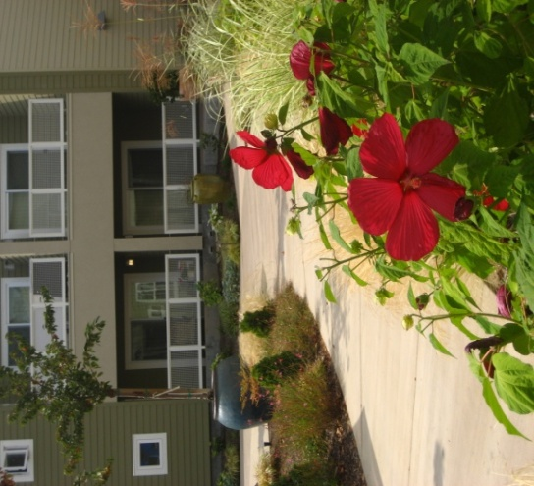
LINCOLN COURT, OAKLAND
Innovative green building techniques & rooftop solar panels
Blight replaced with high- quality, desirable housing
The development has had positive economic, social, and environmental impacts in neighborhood
Neighborhood crime
dropped by 40%
Spurred revitalization of
entire Dimond District
Domus Development, LLC
INFILL DEVELOPMENT
Notes:
9

Slide 10
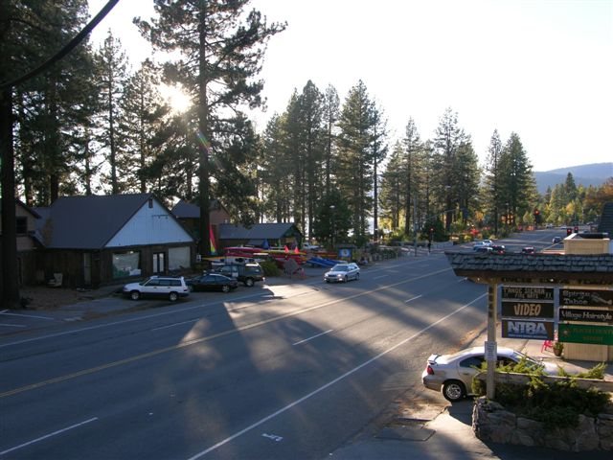
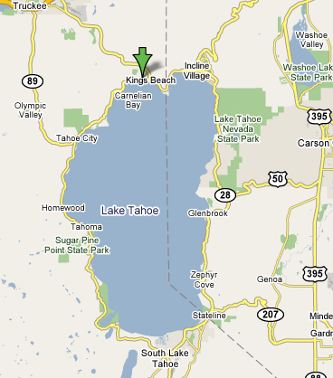
KINGS BEACH, CA
Tahoe is renowned for water clarity & losing clarity at a rate of 1 foot per year
Sensitive environment, governed by two agencies; Placer County and Tahoe Regional Planning Agency (TRPA)
Oldest urbanized area, established 1926
Rural community of about 4,000 residents
Highly regulated land use
Poor infrastructure and lack of Best Management Practices (BMPs)
Domus Development, LLC
INFILL DEVELOPMENT
Notes:
10

Slide 11
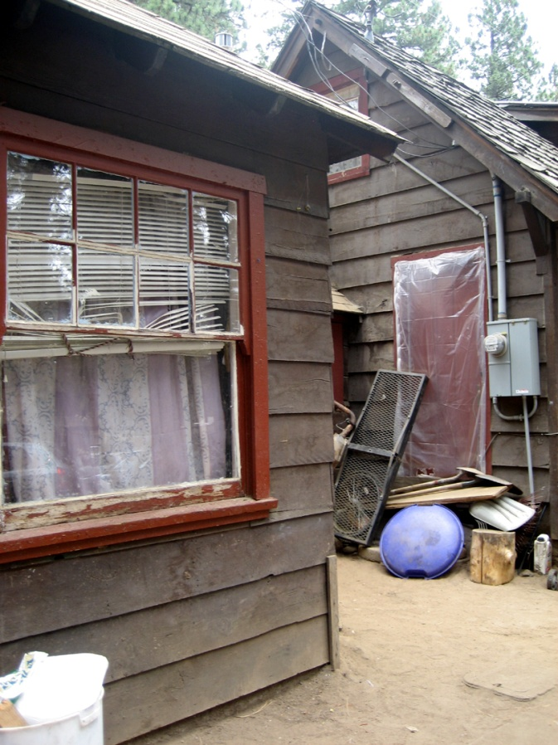
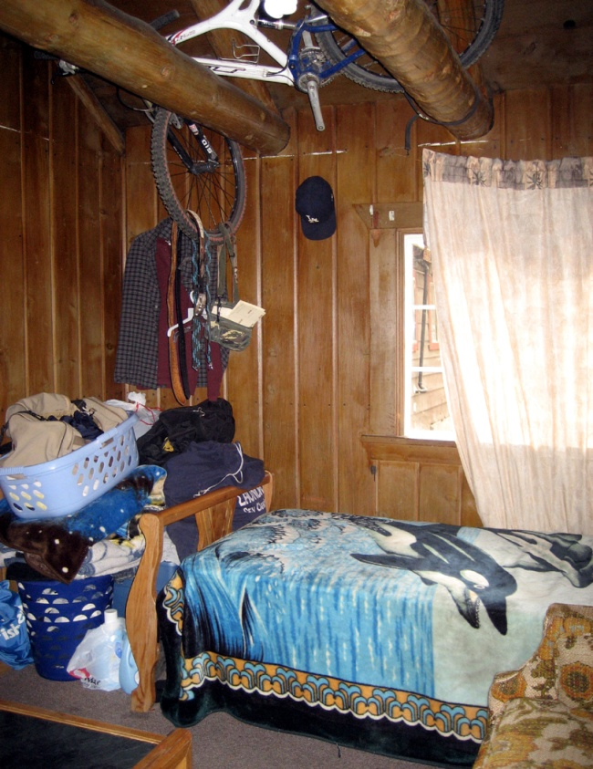
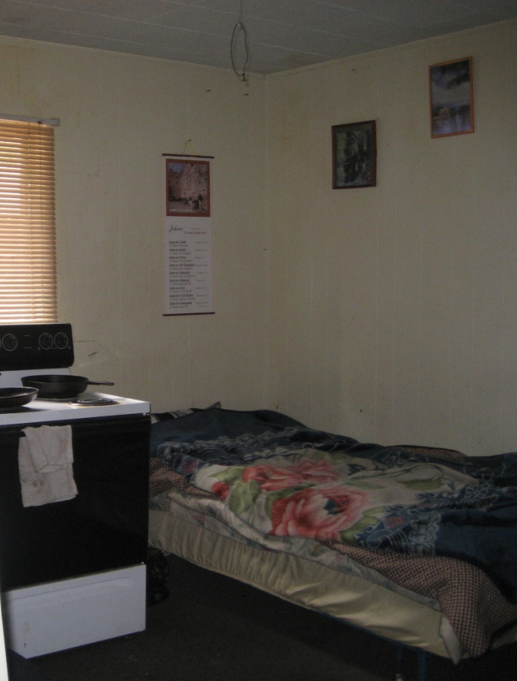
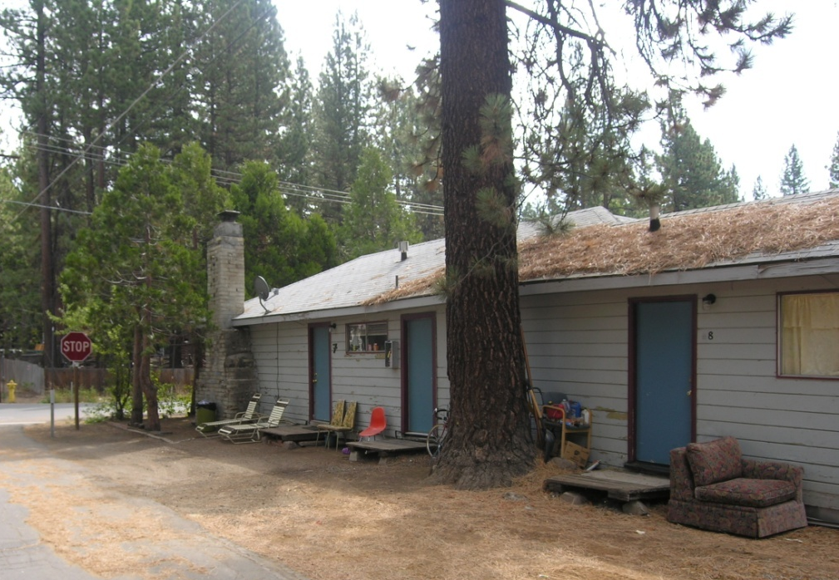
2009 CONDITIONS
Domus Development, LLC
INFILL DEVELOPMENT
Notes:
11

Slide 12
KINGS BEACH HOUSING NOW
First Deed Restricted Affordable Housing
Redevelops 5 infill sites
Demolished 32 units of substandard unsustainable dwellings
Creates 77 eco- friendly apartments; near jobs, transit, schools, parks, grocery stores and restaurants
Domus Development, LLC
INFILL DEVELOPMENT
Notes:
12

Slide 13
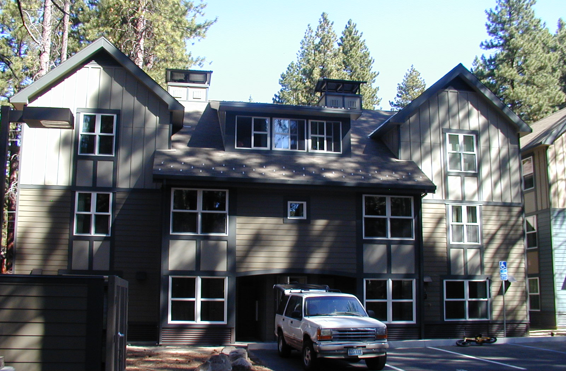
KINGS BEACH HOUSING NOW Fox & Brook Sites, Open Now
Brook
Fox
Domus Development, LLC
INFILL DEVELOPMENT
Notes:
13

Slide 14
KINGS BEACH HOUSING NOW CHIPMUNK SITE Opening Fall 2012
Domus Development, LLC
SMARTER GROWTH
Notes:
14

Slide 15
CHIPMUNK ENVIRONMENTAL STUDY
Chipmunk, the projects largest building, brings many positive environmental improvements, yet CEQA process was lengthy, arduous and expensive
Stringent building and landscape design review, numerous revisions required
Costly requirements including LEED certified buildings, traffic mitigation fees, earthwork “fees”, 100% on-site storm water retention and new County storm water detention basin
Off-site work required: road widening, bus stop, new infrastructure, under-grounding of utilities, which required additional mitigation
Formal Biological Evaluation regarding endangered species
Archaeologist on-call
Domus Development, LLC
INFILL DEVELOPMENT

Slide 16
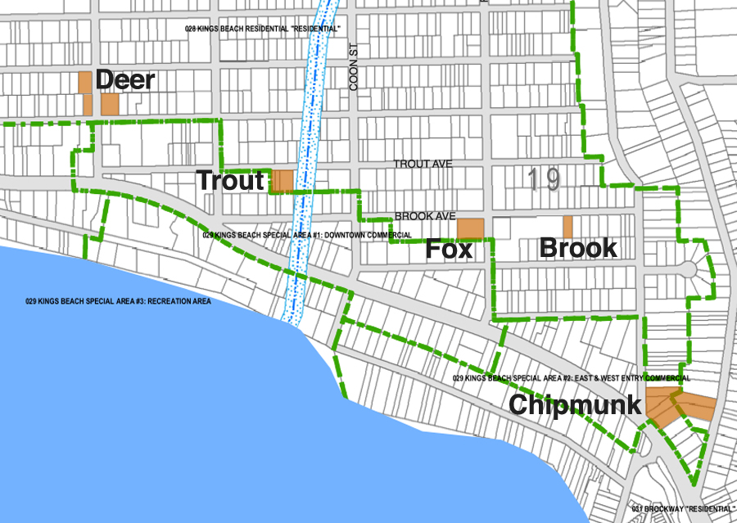
KINGS BEACH HOUSING NOW PROJECT OUTCOMES
Contributes to the long-term economic and environmental vitality of the region; workforce can afford to live close to jobs
Promotes a healthier environment through:
LEED buildings
Storm water management
“Smart growth” practices
Builds on transit nodes
Redevelops existing disturbed, blighted and
underutilized properties within exiting “grid” protecting surrounding land
Domus Development, LLC
INFILL DEVELOPMENT
Notes:
16

Slide 17
CONCLUSION
CEQA’s intent is to protect the environment, but it creates uncertainty for infill developments that inherently protect green fields, reduce CO2 emissions and stimulate economic growth.
CEQA exemptions are useful to infill projects, however, well-designed projects are still subject to litigation risk, excessive and costly reviews and mitigations.
Need to craft better exemptions so more projects can qualify, limit litigation risk, and streamline review process.
Development of the Performance Measures to implement SB 226 could show the way to the kinds of infill projects that should be considered for additional streamlining.
Domus Development, LLC
INFILL DEVELOPMENT

Slide 18
THANK YOU!
Meea Kang, President
Domus Development California Infill Builders Association
meea@domusd.com www.infill-builders.org
415-856-0010 x 8801
www.domusd.com

