Slide 1
JUDICIAL Clerkships
NUTS & BOLTS OF THE APPLICATION PROCESS

Slide 2
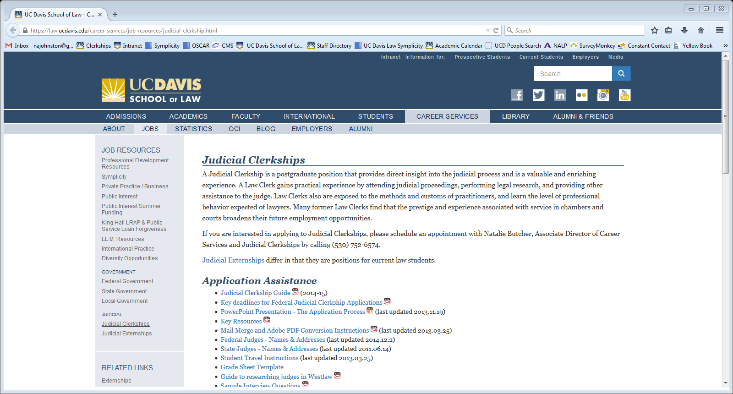
Takeaways
Prestigious: Apply broadly & on many levels
Timeline: 2L Summer to
beyond bar results, alumni
Resources: alumni clerks and
evaluations
https://law.ucdavis.edu/career-services/job-resources/judicial-clerkship.html

Slide 3
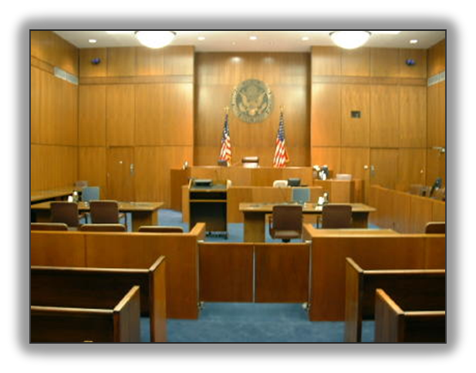
What is a Clerkship?
Post-graduate position
1 or 2-year term
Work with a single judge or pool of staff attorneys to manage a caseload
Conduct legal research, perform legal analysis, draft opinions, prepare memoranda, edit and check citations

Slide 4
Why?
An insider’s perspective
Broad exposure
Intensive training/skill development
Mentoring
A Career Boost
Networking

Slide 5
Where? – Court Level
FEDERAL
STATE
US Supreme Court
Federal Cir. Court of Appeals
US Court of Federal Claims
US Court of Int’l Trade
US Court of Vet. Appeals
US Courts of Appeals for the Armed Forces
US Courts of Appeal
US District Courts, Bankruptcy, Magistrate
Tax Court
Administrative Agencies
State Supreme Courts
Intermediate Appellate Courts
Trial Courts/Courts of General Jurisdiction
Courts of Limited Jurisdiction
Tax
Family
Etc.

Slide 6
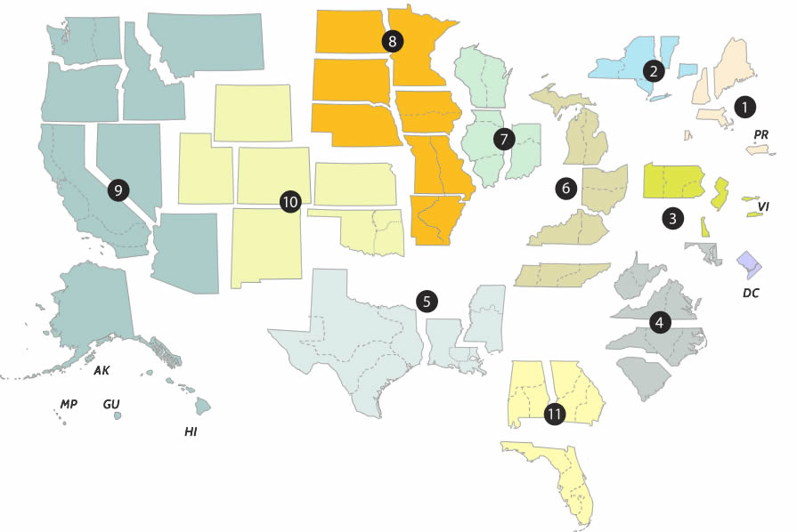
Federal Circuits

Slide 7
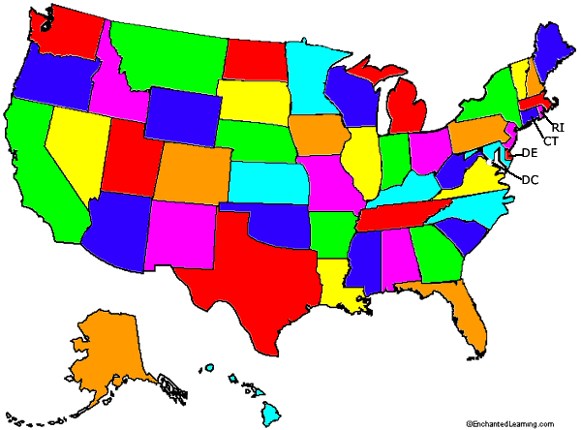
STATE COURTS

Slide 8
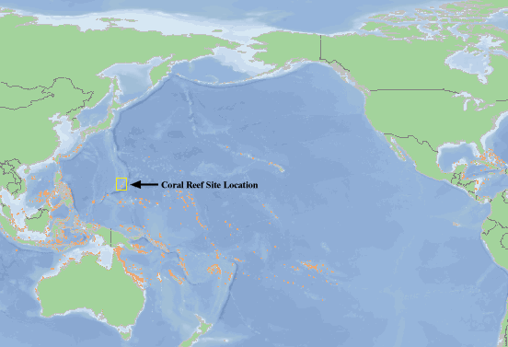
Clerkships!

Slide 9
When?
FEDERAL
d
State
STATE
Federal Law Clerk Hiring Plan
January 8, 2024 – Access available to register in OSCAR (Online System for Clerkship Application and Review) and search, build applications
June 10, 2024 at 9 AM PT – Applications released to federal judges in OSCAR
Not in OSCAR or do not use - contact chambers directly
Administrative Judges:
Clerkships webpage – “Federal ALJ Post Graduate Clerkships”
Varies by state, court & judge
See Vermont Law School Directory on State Clerkships and Insight and Inside Information
Court Opportunity Recruitment for All (CORA)
Oregon – Spring 2L
Nevada – Winter 3L
Hawaii – Winter 3L
Colorado – After spring semester 2L
Alaska – 3L Fall OCI
Guam - 3L

Slide 10
How to Apply?
Federal
State
STATE
OSCAR (online)
https://oscar.uscourts.gov/
Limit of 100 electronic applications at any time
Email Applications
Paper Applications
Court Opportunity Recruitment for All (CORA)
Electronic applications through websites or email
Paper Applications

Slide 11
Paper Applications
400 Max (200 MAX Fed, 200 MAX State)
80 paid for by the law school including envelopes, labels, and postage.

Slide 12
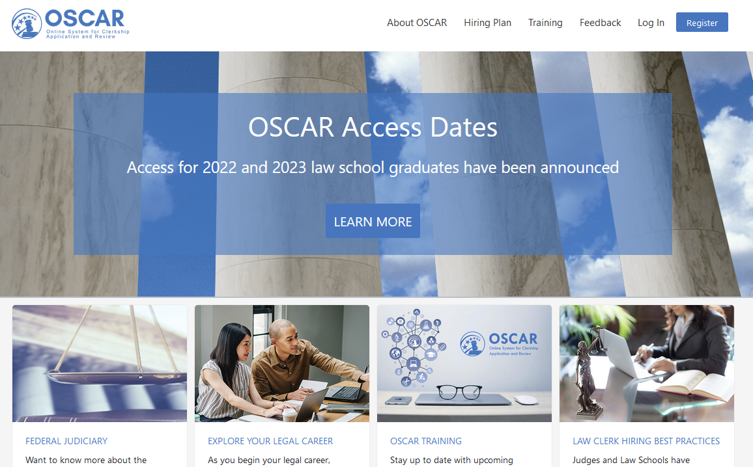

Slide 13
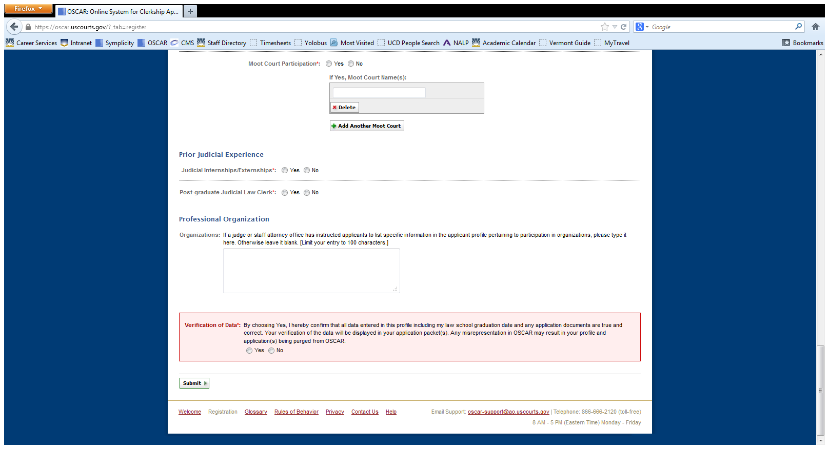

Slide 14
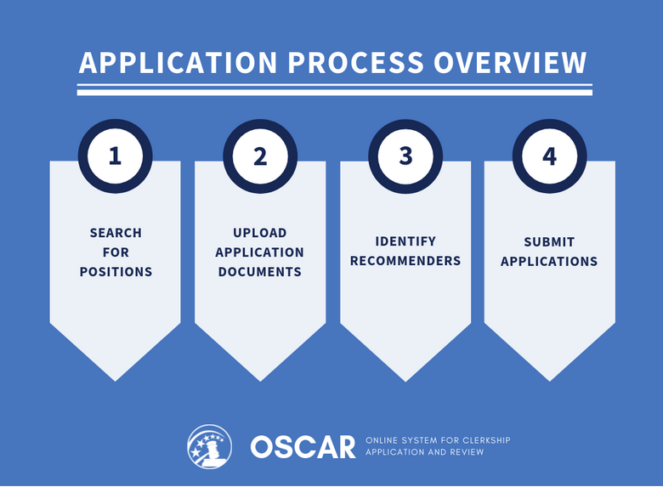

Slide 16
How?
Appointment to discuss individual application strategy based on class rank and connections
Complete judicial clerkship survey (https://intranet.law.ucdavis.edu/community/career/files/Clerkship-Survey-2021.docx) and return with resume to CSO
Research judges and create list
Set up meetings with recommenders to request letters. Deadline to request letters from faculty: April 8, 2024
Prepare application materials and send to CSO for review

Slide 17
Successful Applications
GPA importance varies by court
Law Review, journal, moot court
Critical thinking, research, writing
Citation and substantive editing
Judicial externship – reference Recommendations from faculty, judge, law clerk
State/local connection
Genuine interest in judge, court, location or legitimate connection

Slide 18
How? – Application Materials
1-page Cover Letter
1-page Resume
Copies of Official Transcripts (Law & Undergrad) / Grade Sheet (OSCAR)
Writing Sample: Unless specified, 5-10 pages double spaced with a COVER SHEET
3 Letters of Recommendation

Slide 19
Cover Letter & Resume
Cover Letter
Resume
1-page MAX
On your “letterhead”
Notice watermark direction
11-pt font, 0.75-in margins
Date on left side
Closing line on left-side
Date, Address, Salutation
Dear Judge ______:
Thank the judge!
1-page MAX
On your “letterhead”
Avoid abbreviations & symbols: No. versus #, intellectual property v. IP
11-pt font, 0.75-in margins
UC Davis School of Law
J.D. Candidate, 2024
USE “right-tab”

Slide 20
Dear Judge Last:
As a second-year student and a member of Law Review at UC Davis School of Law, I am writing to request consideration for a clerkship in your chambers for the 2025-2026 term.
I am currently a member of the UC Davis Law Review and a senior articles editor on the Business Law Journal. Last summer, I served as an extern for Judge Berzon of the Ninth Circuit. I wrote bench memoranda and drafted memorandum dispositions. I also helped prepare the Judge for oral arguments. I thoroughly enjoyed the experience, which made me eager to apply for a clerkship. This summer, I will work as a summer associate for Small, Mid, and Large LLP in Los Angeles.
Enclosed are a copy of my résumé, a transcript, and a writing sample for your review. The writing sample is a redacted copy of a Motion for Summary Judgment I drafted last summer. Letters of recommendation from Professors Sam Ikuta, Jean Lee, and Sarah Jones will be sent directly from the law school.
I consider a judicial clerkship to be a unique and valuable experience. I would appreciate the opportunity to meet with you to discuss how I can contribute to your chambers. Thank you for your time and consideration.
Sincerely,
SIGNED
Student Full Name

Slide 21
EDUCATION
UC Davis School of Law (GPA: x.xx , Class Rank: Top 10%) J.D. Candidate, 2025
Member, UC Davis Law Review: provided substantive editing skills and drafted student note.
Recipient, Reynoso Acheivement Award: awarded Highest Grade in Contracts Law.
Recipient, King Scholar: exemplified Dr. King’s effort to achieve social and political justice.
UC Los Angeles B.A., Government, magna cum laude, 2022
Recipient, High Honors and Distinction in Scholarship: awarded for academic merit and Senior Thesis.
Author, “South Sudan: Building Democracy in the Youngest Nation in the World,” UCLA Compilation of Undergraduate Papers (2018).
EXPERIENCE
Davis, King, and Silo LLP, Summer Associate Summer 2024
Draft multiple motions to dismiss and a motion for summary judgment for federal court cases.
Research and draft various memoranda on recent patent litigation case law.
Attend client meetings, and participate in annual firm retreat to Palm Springs.
U.S. Department of Justice Criminal Division, Law Clerk Summer 2023
Drafted Ninth Circuit appellate brief in a murder case involving trying a minor as an adult.
Drafted multiple research memoranda related to internet crime, and crime and technology.

Slide 22
Writing Samples
A filed appellate and/or amicus brief (public)
A (published) law review article
Moot court brief (or part of one)
Research memo (confidentiality concerns!)
An order (public but minimal complexity)
COVER SHEET with context of sample, addressing confidentiality concerns, & amount of external editing.

Slide 23
INTERVIEWING
Do NOT accept an interview if you would not accept that offer
Respond immediately and schedule your interview at the earliest opportunity
The Law School may cover up to fifty percent of travel cost
Prepare to accept or decline on the spot
Not an area to bid up your offers
As soon as you accept, withdraw all other apps
Judges often conduct background checks after accept offer, consult Career Services prior to interview regarding when to disclose
Consult/Update Career Services to get a mock interview scheduled with faculty
Fill out an interview evaluation in Symplicity (Judicial Clerkship section) or word doc

Slide 24
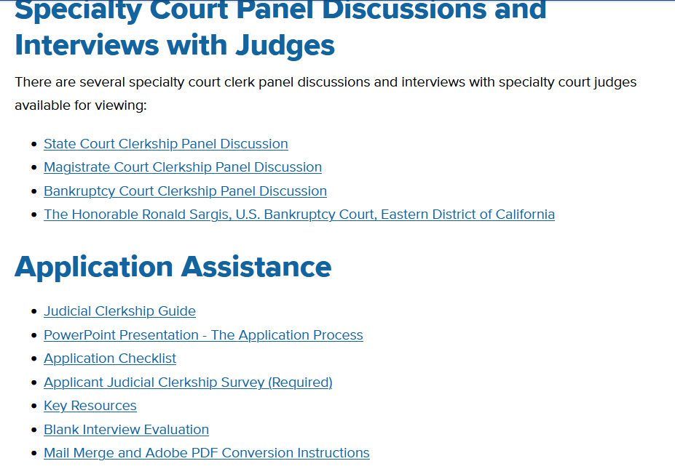

Slide 25
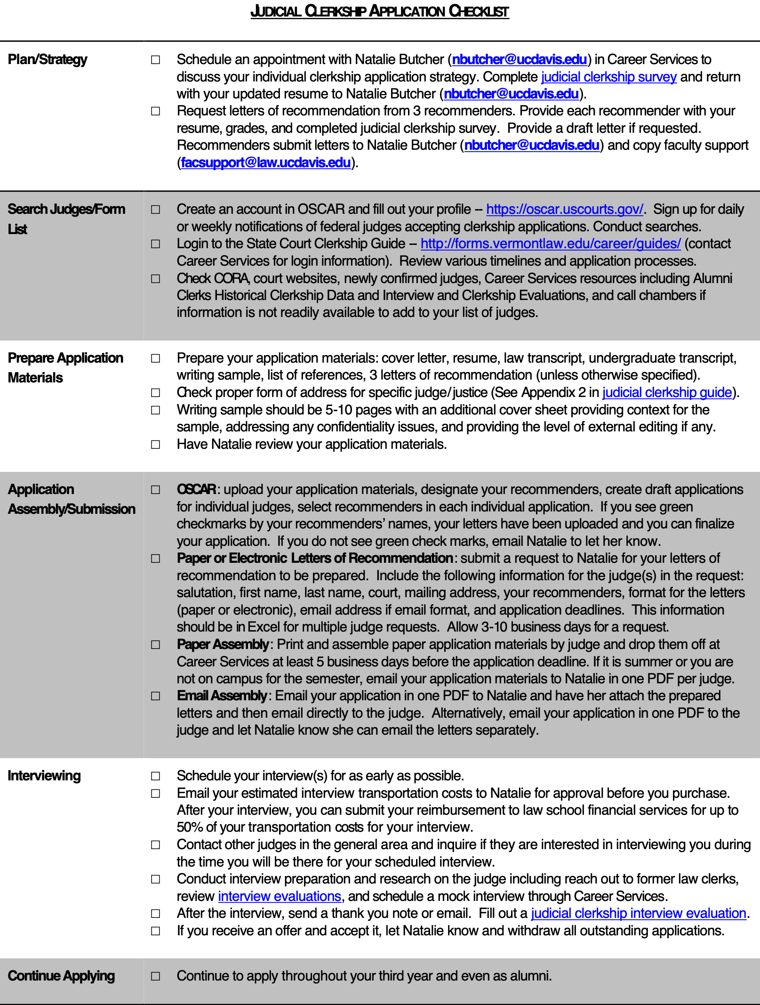

Slide 26
Questions?
Natalie J. Butcher
Associate Director of Career Services
& Judicial Clerkships
(530) 752-6574
nbutcher@ucdavis.edu

